Slide 1
RGX-121, An Investigational Gene Therapy for the Treatment of Severe Mucopolysaccharidosis Type II (MPS II)
CAMPSIITE™ Phase I/II/III: A Clinical Study Update
Paul Harmatz, MD
Professor, Pediatrics
UCSF Benioff Children’s Hospital, Oakland, CA
SSIEM, Jerusalem Israel, August 30, 2023

Slide 2
AAV Gene Therapy Has the Potential to Address Unmet Need in MPS II
High Unmet Need in MPS II
Potential of RGX-121 for MPS II
Incidence of MPS II
Prevalence
AAV9 Vector + IDS Transgene
Attenuated
MPS II
~25%
Severe
MPS II
~75%
1 in 100,000
to
1 in 170,000
RGX-121, an investigational gene therapy, may provide meaningful advantages over standard of care
One-time administration
Image-guided administration allows direct delivery of IDS transgene to cells in the CNS
May allow cells to produce functional I2S protein and cross-correct other cells
Potential for long-term expression of I2S
May prevent CNS disease progression
MPS II, also known as Hunter syndrome, is a rare X-linked recessive genetic disease
Caused by a deficiency of iduronate-2-sulfatase (I2S), an enzyme required for the degradation of the glycosaminoglycans (GAGs) which results in GAG accumulation
Causes systemic symptoms, neurodegeneration and leads to early death
Standard of care includes IV enzyme replacement therapy (ERT), which does not address CNS disease involvement
1. Martin (2008) Pediatrics
2. Scarpa, https://www.ncbi.nlm.nih.gov/books/NBK1274) 2007; Updated 2018

Slide 3
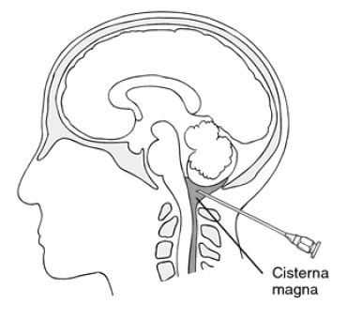
RGX-121: CAMPSIITE Part 1, Phase I/II
NCT03566043 on ClinicalTrials.gov
Participants
Cohorts (dose levels) Genome copies/g brain mass
Data
Enrollment up to 16 severe MPS II partcipants
(≥ 4 months to ˂ 5 years of age)
May be on Standard of Care IV ERT
or ERT Naïve
Primary Endpoint: Safety
Secondary & Exploratory
Endpoints Include:
CSF GAGs
Neurodevelopmental Assessments (Bayley)
Caregiver Reported Outcomes (VABS; SDSC)
Systemic Biomarkers (urine & plasma GAGs)
RGX-121
AAV9 + IDS
Cohort 1: 1.3 x 10¹⁰
Cohort 2: 6.5 x 10¹⁰
Cohort 3: 2.9 x 10^{11 *}
Primary Safety Endpoint (24 weeks)
Screening
RGX-501
Long-term Follow Up Study
Yearly Assessments
Treatment Evaluation
Single Direct to CNS
Injection of RGX-121
Immunosuppression
Regimen (48 weeks)
(104 weeks)
IV ERT
Option to discontinue after week 52
Bayley (Bayley Scales of Infant and Toddler Development, 3rd Edition); VABS (Vineland Adaptive Behavior Scales, 2nd Edition); SDSC (Sleep Disturbance Scale for Children)
* Cohort 3 was previously reported as 2.0 x10¹¹ GC/g of brain mass based on a Poly-A-specific PCR assay. This is equivalent to 2.9x10¹¹ GC/g of brain mass using a transgene-specific PCR assay
Notes:
Voiceover: mention that CAG promoter used in RGX-121 transgene

Slide 4
RGX-121 Phase I/II Cohorts
15 participants dosed as of January 3, 2023
Age at dosing ranged from 5 months to 59 months
IDS Mutations among severe MPS II trial participants included deletion, frameshift, gene inversion, insertion, missense, splicing, and substitution
Study duration 104 weeks. At the end of the study, participants were invited to participate in a long-term follow-up study for a total of 260 weeks (5 years)
Immunosuppression discontinued in all eligible participants (n = 13) per protocol
Cohort | N | Dose (GC/g Brain Mass) | Follow-Up (Weeks) | Immunosuppression Regimen Status | ERT (IV) Status†
Cohort 1 | 3 | 1.3 x 10¹⁰ | 154-208 wk | 3 completed | 3 weekly*
Cohort 2 | 7 | 6.5 x 10¹⁰ | 61-160 wk | 7 completed | 2 weekly 4 discontinued 1 naïve
Cohort 3 | 5** | 2.9 x 10^{11***} | 8 to 78 wk | 3 completed 2 active | 3 weekly 1 discontinued 1 naïve
† Protocol allows ERT discontinuation after Week 52
* 2 participants who discontinued restarted weekly ERT
** Limited data shown for 2 recently dosed participants
*** Cohort 3 was previously reported as 2.0 x10¹¹ GC/g of brain mass based on a Poly-A-specific PCR assay. This is equivalent to 2.9x10¹¹ GC/g of brain mass using a transgene-specific PCR assay.
Data cut January 3, 2023
Notes:
Weeks follow up indicates total time of follow-up ; data may not be shown for all time points because sample collection, processing, and entering into database lags reporting.

Slide 5
CAMPSIITE Interim Safety Summary
SAE | No SAEs are considered related to RGX-121 or the administration procedure 12 serious adverse events (SAE; 8 in main study, 4 in LTFU) reported in 7 participants: SAEs reported in main study: HSV gingivostomatitis*, fever requiring hospitalization, infection of VP shunt, viral meningitis*, hydrocephalus, laryngospasm, cerebellar/cerebral infarction, seizures SAEs reported in LTFU: Tonsillitis, Pharyngitis, Viral URI, URI All SAEs resolved
TEAE | No dose-related safety findings and no long-term safety concerns were observed All participants reported treatment emergent adverse events (TEAEs) which were predominantly mild 6 AESIs (adverse events of special interest) reported, all considered related to immunosuppression regimen, all resolved, with HSV gingivostomatitis being the most common
RGX-121 has been well tolerated
* Possibly related to immunosuppression
Data cut January 3, 2023
Notes:
(?) Weeks follow up indicates total time of follow-up ; data may not be shown for all time points because sample collection, processing, and entering into database lags reporting.

Slide 6
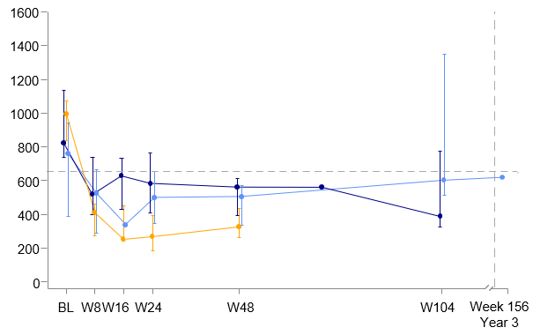
Cerebrospinal Fluid (CSF) GAGs: Heparan Sulfate (HS)
Cohort 1 n = 3
Cohorts (median†)
% Reduction
Individual Participants
Cohort 2 n = 7
Cohort 3 n = 4
Cohort | Week 8 | Week 24 | Week 48
1 | -29.5% n=3 | -20.6% n=2 | -33.5% n=3
2 | -42.3% n=6 | -36.4% n=7 | -48.9% n=6
3 | -58.7% n=4 | -74.9% n=3 | -64.7% n=3
1600
1400
1200
1000
CSF HS (ng/mL)
800
Maximum attenuated
600
*
400
200
0
S
A
N
BL
W24
W48
W104
Week 156
Year 3
Time on Study (Weeks)
Week 48 CSF HS measurements continued to show dose-dependent reductions in Cohorts 1-3
13 of 14 participants in all three cohorts demonstrated decreased CSF HS from baseline at last time point available*
* CNS related clinical event (ventriculoperitoneal shunt infection) deemed unrelated to study drug took place on Day 522 post RGX-121 administration in this Cohort 1 participant
† Median CSF HS concentration +/- Q1 and Q3 per cohort.
Normative data are based on 29 normal samples. The ages for 9 normative (N) samples range from 1 month to 21 years old.
Severe (S) defined as IQ < 70. The ages of 3 severe samples range from 4 years 8 months to 10 years old.
Attenuated (A) defined as IQ > 70. The ages of 4 attenuated samples range from 11 years to 29 years old.
Data cut January 3, 2023
Notes:
Participant with VP shunt infection is the only participant above baseline

Slide 7
Cerebrospinal Fluid (CSF) GAGs: Durable Reductions in Heparan Sulfate (HS) in Cohort 3 up to 48 weeks
Cohort 1 n = 3
Cohorts (median†)
% Reduction
Individual Participants
Cohort 2 n = 7
Cohort 3 n = 4
Cohort | Week 8 | Week 24 | Week 48
1 | -29.5% n=3 | -20.6% n=2 | -33.5% n=3
2 | -42.3% n=6 | -36.4% n=7 | -48.9% n=6
3 | -58.7% n=4 | -74.9% n=3 | -64.7% n=3
1600
1400
1200
1000
CSF HS (ng/mL)
800
Maximum attenuated
600
*
400
200
0
S
A
N
BL
W24
W48
W104
Week 156
Year 3
Time on Study (Weeks)
Week 48 CSF HS measurements continued to show dose-dependent reductions in Cohorts 1-3
13 of 14 participants in all three cohorts demonstrated decreased CSF HS from baseline at last time point available*
* CNS related clinical event (ventriculoperitoneal shunt infection) deemed unrelated to study drug took place on Day 522 post RGX-121 administration in this Cohort 1 participant
† Median CSF HS concentration +/- Q1 and Q3 per cohort.
Normative data are based on 29 normal samples. The ages for 9 normative (N) samples range from 1 month to 21 years old.
Severe (S) defined as IQ < 70. The ages of 3 severe samples range from 4 years 8 months to 10 years old.
Attenuated (A) defined as IQ > 70. The ages of 4 attenuated samples range from 11 years to 29 years old.
Data cut January 3, 2023
Notes:
Participant with VP shunt infection is the only participant above baseline

Slide 8
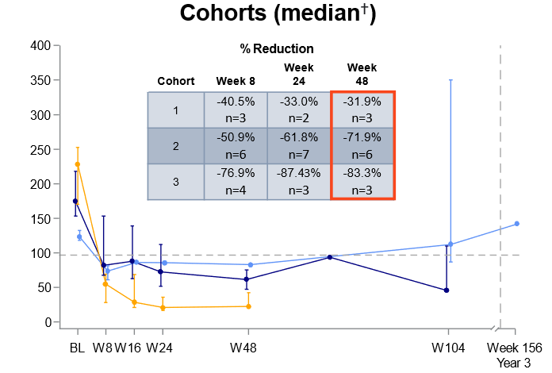
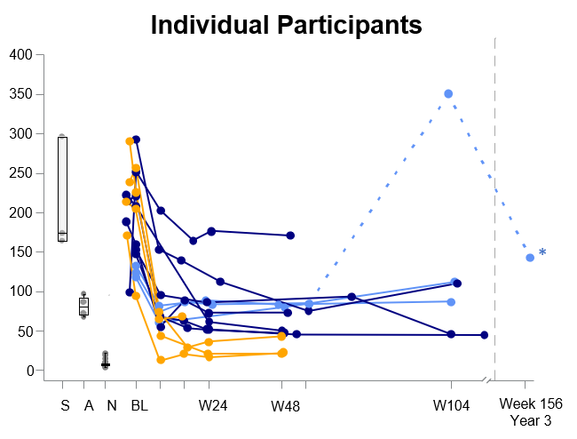
CSF GAGs: HS D2S6, a Trisulfated Disaccharide, reduced over 80% in Cohort 3 D2S6 is a Correlate of Neuropathology Phenotype in Severe MPS II¹⁻³
Cohort 1 n = 3
Cohort 2 n = 7
Cohort 3 n = 4
CSF D2S6 (ng/mL)
Maximum attenuated
Time on Study (Weeks)
Week 48 CSF HS D2S6 measurements continued to show dose-dependent reductions across cohorts, with Cohort 3 participants approaching normal levels
13 of 14 of participants in all three cohorts demonstrated decreased CSF HS D2S6 from baseline at last time point available*
Measurable CSF I2S protein concentration in 10 of 11 Cohort 2 & 3 participants after RGX-121 administration
1. Holley (2011) J Biol Chem 2. Wilkinson (2012) PLoS One 3. Gleizt (2018) EMBO Mol Med
* CNS related clinical event (ventriculoperitoneal shunt infection) deemed unrelated to study drug took place on Day 522 post RGX-121 administration in this Cohort 1 participant
† Median CSF D2S6 concentration +/- Q1 and Q3 per cohort.
Normative data are based on 29 normal samples. The ages for 9 normative (N) samples range from 1 month to 21 years old.
Severe (S) defined as IQ < 70. The ages of 3 severe samples range from 4 years 8 months to 10 years old.
Attenuated (A) defined as IQ > 70. The ages of 4 attenuated samples range from 11 years to 29 years old.
Data cut January 3, 2023

Slide 9
Neurodevelopment Assessments Bayley Scales of Infant and Toddler Development, 3rd Edition (BSID-III)
Participants were assessed using the BSID-III
Age Equivalent (AEq) data is presented for the BSID-III Cognitive, Expressive Language and Fine Motor subtests
BSID-III manual normative data were used to characterize ±1 and ±2 standard deviation (SD) boundaries for the AEq score¹
Participants were separated by baseline BSID-III cognitive function
AEq change from baseline (CFB) is defined by:
Increase: ≥3 mo AEq
Stability: -3 mo < CFB < 3 mo AEq
Decline: < -3 mo AEq
78
+/
-
+/
1S
D
-
72
2S
D
66
13 Participants with > 6 months follow-up separated by baseline function on cognitive subtest
60
> -2SD
54
48
42
Age Equivalence (months)
36
Participants at baseline with cognitive function ≥ -2 SD from the normative mean
Cohort 1, n = 3
Cohort 2, n = 1
Cohort 3, n = 1
Participants at baseline with cognitive function below -2 SD from the normative mean
Cohort 2, n = 6
Cohort 3, n = 2
30
< -2SD
24
18
12
6
0
0
6
12
18
24
30
36
42
48
54
60
66
72
78
Age (months)
Cho, ICIEM Virtual Congress 2021
Notes:
Participant data is only presented for the BSID-III Cognitive, Expressive Language and Fine Motor subtests in order to illustrate the functional impacts of CNS dysfunction. Receptive language is not included in the presentation because conceptually it overlaps with the cognitive subtest. Gross motor is not included as it focuses more on systemic impact of MPS II.
All data is presented as age equivalent scores (AEq) but referenced to typical function through development of ±1 and ±2 standard deviation (SD) boundaries. The boundaries were created by Cho et al ( 2021) by extracting the original BSID-III normative data and modeling by AEq and age.

Slide 10
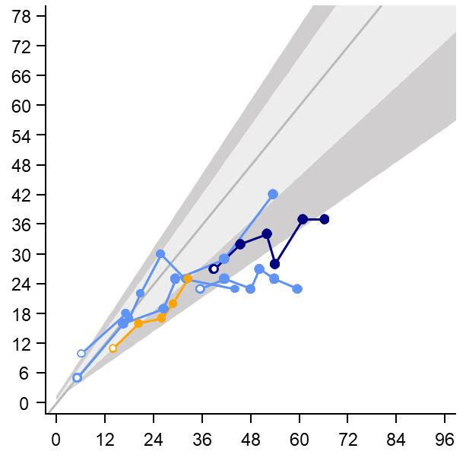
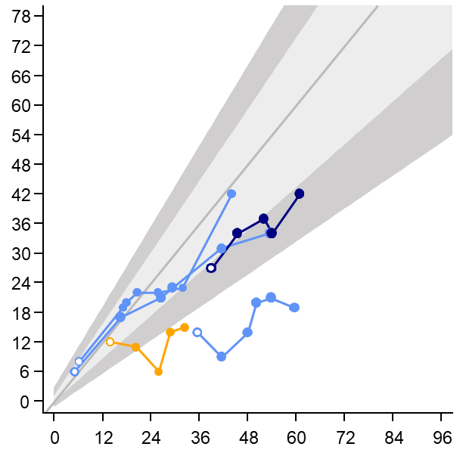
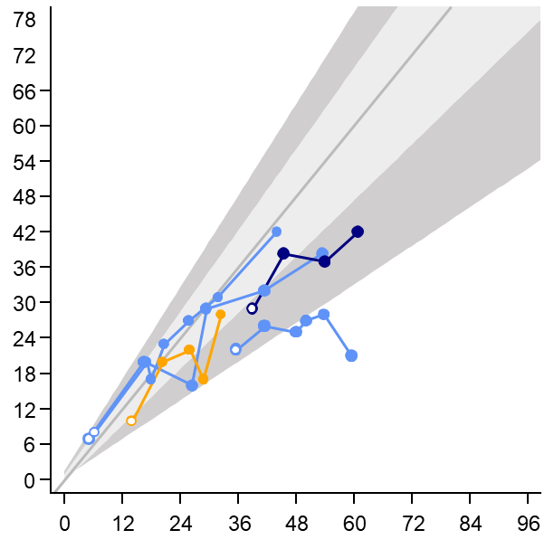
Neurodevelopmental Function Baseline BSID-III Cognitive Function > -2SD
Cohort 1
Cohort 2
Cohort 3
Cognition
Expressive Language
Fine Motor
+/
-
+/
1S
D
-
1S
D
+/
-
1S
D
+/
-
+/
2S
D
-
2S
D
+/
-
2S
D
Age Equivalence (months)
Age (months)
The majority of participants with baseline function >-2SD have developmental function that
remained within that range on at least 2 domains
Includes participants (n = 5) with > 6 months of follow-up
Data cut January 3, 2023
Notes:
2 participants have achieved the BSID-III maximum subtest scores (42 months AEq) (to discuss)

Slide 11
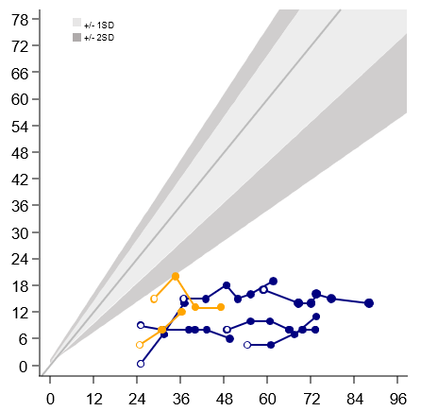
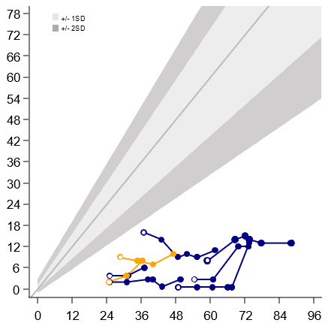
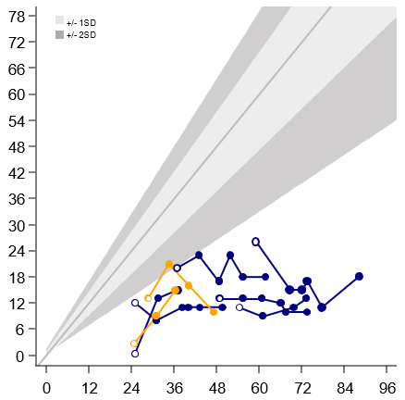
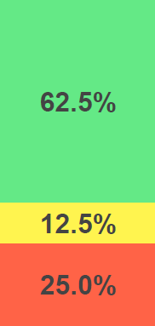
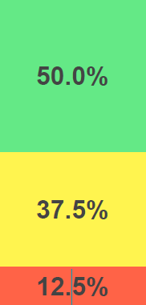
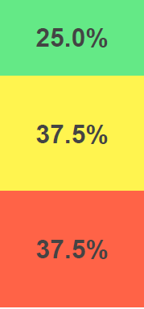
Neurodevelopmental Function Baseline BSID-III Cognitive Function Below -2 SD
Expressive Language
Fine Motor
Cognition
Cohort 2
Cohort 3
Age Equivalence (months)
Age (months)
The majority of participants with baseline function below -2SD stabilized or had an
increase of > 3 mo in AEq on cognitive, expressive, language or fine motor subtests
Includes participants (n = 8) with > 6 months of follow-up
Change from baseline (CFB) is defined as: Increase > 3 mo AEq; Stabilization -3 < CFB < 3 mo AEq; Decrease < -3 mo AEq
Data cut January 3, 2023

Slide 12
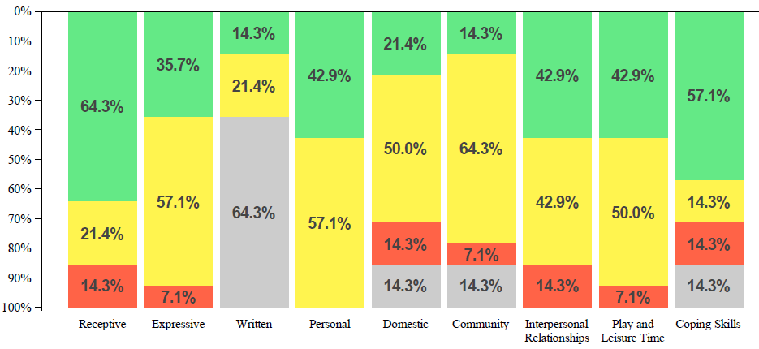
Vineland Adaptive Behavior Scales Second Edition (VABS-II) VABS measures adaptive behavior, defined as the personal and social skills for everyday living*
Communication
Daily Living
Socialization
The majority of participants demonstrated
stabilization or ongoing skill acquisition on age-appropriate subtests of communication, daily living and socialization
Includes participants (n = 14) with > 6 months of follow-up
* The percent of participants for whom the subtest was not able to be assessed due to age
Change from baseline (CFB) is defined as: Increase > 3 mo AEq; Stabilization -3 mo< CFB < 3 mo AEq; Decrease < -3 mo AEq
Data cut January 3, 2023
Notes:
The majority of participants demonstrated stabilization or ongoing skill acquisition on age relevant daily living and socialization subtests

Slide 13
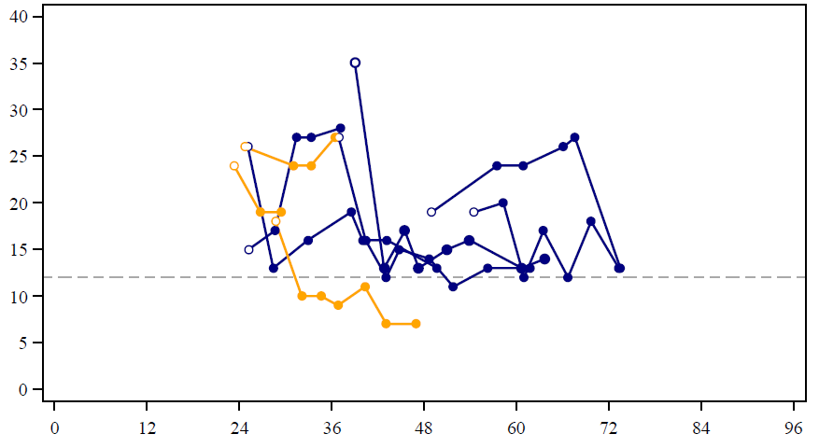
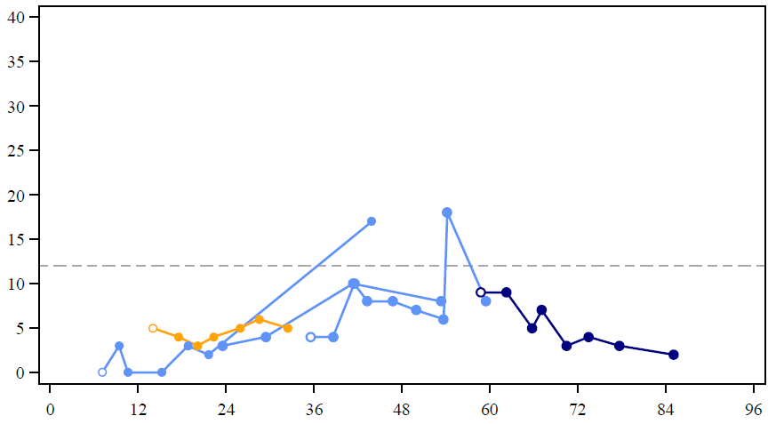
VABS-II Maladaptive Behavior Index
Maladaptive behaviors, a measure of undesirable behaviors that interfere with daily functions, are associated with neurodegeneration
Participants are classified according to level of maladaptive behavior at baseline and compared to average performance age for range.
Cohort 1
Cohort 2
Cohort 3
Change in Maladaptive Behavior in Participants with
Elevated Score at Baseline (> 12)
Change in Maladaptive Behavior in Participants with
Average Score at Baseline (< 12)
Improvement
Maladaptive Behavior Index
Average Performance for Age
Age (months)
At last time point assessed
7 of 9 participants with elevated maladaptive behavior at baseline achieved a reduction in maladaptive behavior score
4 of 5 participants with average maladaptive behavior for age at baseline maintained average maladaptive behavior score
Sparrow (2005) Vineland II
VABS-II data include participants with at least one post-baseline assessment OR Includes participants (n = 14) with > 6 months of follow-up
Maladaptive Behavior Index (MBI) includes one participant without baseline data. This participant was enrolled under an earlier protocol version that did not require MBI
Data cut January 3, 2023
Notes:
Previous – change so more positive
9 of 14 participants had an elevated Maladaptive Behavior Index at Baseline. 8 of 9 show a reduction in undesirable behaviors
5 participants had average behavior for age. 1 of 5 show an increase in undesirable behaviors

Slide 14
RGX-121 CAMPSIITE Part 1, Phase I/II Summary of Interim Results
Safety: RGX-121 was well tolerated
As of January 3, 2023, 15 participants have been dosed with RGX-121
RGX-121 has been well tolerated across 3 cohorts with no SAE related to study drug or administration procedure
CNS: CSF GAGs and neurodevelopmental assessments continue to indicate an encouraging RGX-121 profile
Dose-dependent, durable reductions in CSF GAGs demonstrated across cohorts
Cohort 3 CSF HS D2S6 continued to approach normal levels at 48 weeks
Neurodevelopmental and daily activity skill acquisition was observed up to 3 years after RGX-121 administration
Treatment response appeared to be dependent on the extent of neurodevelopmental deficits at baseline
Systemic: Evidence of enzyme expression and biomarker activity after CNS RGX-121 administration*
Majority of participants demonstrated increases in plasma I2S concentration
Urine GAG measures showed evidence of systemic effect of RGX-121 independent of ERT treatment
REGENXBIO has taken Dose 3 into a pivotal program
* Data not presented
Data cut January 3, 2023

Slide 15
Acknowledgements
The RGX-121-101 Investigators
REGENXBIO
Can Ficicioglu, Children’s Hospital of Philadelphia
Roberto Giugliani, Hospital de Clinicas, Porto Alegre, Brazil
Paul Harmatz, UCSF Benioff Children’s Hospital
Deepa Rajan / Maria Escolar – University of Pittsburgh
Nidal Boulos
Yoonjin Cho
Paulo Falabella
Michele Fiscella
Michelle Gilmor
Joe Hagood
Caroline Mulatya
Laura Pisani
Dawn Phillips
Catherine Wilson
Lin Yang
The Study Coordinators (Diana Julca Aguinaga, Dawn Kolar, Ryan Kuehl, Alex Schramm, Matt Thura, Francis Krawiec, Alyssa Kohler, and Marina Zambrano) Research Assistants, and Study Teams at the Clinical Study Sites
The MPS II patients and their families

Slide 17
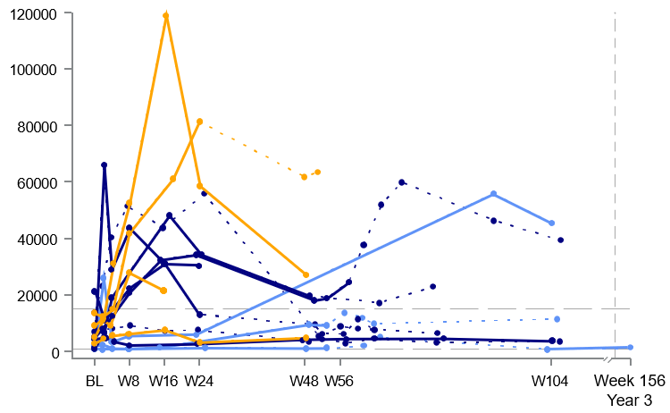
Systemic Effects Plasma I2S Protein Concentration
I2S Concentration
Cohort 1
Cohort 2
Cohort 3
ERT naïve /
Post-ERT Withdraw
Time on Study
Increased plasma I2S protein concentration at last time point available was observed in the
majority of participants after RGX-121 administration
Data cut January 3, 2023

Slide 18
Systemic Effects Urine GAGs
1
6
0
1
4
0
ERT Naive at Dosing
1
2
0
Post ERT Withdrawal
Pre ERT Withdrawal/ERT Initiated
1
0
0
8
0
Total GAG, Urine (g/mol CK)
6
0
4
0
2
0
0
B
L
W
8
W
1
6
W
2
4
W
3
2
W
4
0
W
4
8
W
5
6
W
7
8
W
1
0
4
Time on Study (Weeks)
Urine GAG measures showed evidence of systemic effect of RGX-121 independent of ERT treatment
ERT Naïve at dosing (n=3) : 2 of 3 participants demonstrated a decrease in total urine GAGs at the last ERT naïve time point available
ERT Withdrawal (N=7): Total urine GAGs following ERT withdrawal remained relatively consistent with total urine GAGs prior to ERT withdrawal
ERT Treated at any timepoints (N=13): 12 of 13 participants demonstrated a decrease in total urine GAGs at the last ERT treated time point available
Data cut January 3, 2023

Slide 19
RGX-121: CAMPSIITE Part 2, Phase III
NCT03566043 on ClinicalTrials.gov
Participants
Dose
Data
Enrollment up to 30 neuronopathic MPS II participants
(≥ 4 months to ˂ 5 years of age)
May be on Standard of Care IV ERT
or
ERT Naïve
If MPS II Phenotype Unknown:
Serial neurodevelopmental assessments up to 12 Months; May screen for intervention if neuronopathic confirmed
Primary Endpoint: CSF GAGs
Co-primary Endpoint:
Neurodevelopmental Assessments (Bayley, Mullen)
Secondary Endpoints:
Safety
Caregiver Reported Outcomes (VABS)
Systemic Biomarkers (I2S, GAGs)
MRI
RGX-121
AAV9 + IDS
2.9 x 10^{11 *}
Genome copies/g brain mass
Long-term Follow up Study
Screening
Treatment Evaluation
RGX-501
Single Direct to CNS
Injection of RGX-121
Immunosuppression
Regimen (48 weeks)
(104 weeks)
IV ERT
Option to discontinue after week 24
Dose is the same as Cohort 3 in CAMPSIITE Part 1 (Phase I/II).
VABS: Vineland Adaptive Behavior Scales
Notes:
Voiceover: mention that CAG promoter used in RGX-121 transgene

