Slide 1

RGX-111, An Investigational Gene Therapy for the Treatment of Severe Mucopolysaccharidosis Type I (MPS I)
Interim Analysis of the First in Human Study and
a Single IND Patient
Raymond Y. Wang, MD
Division of Metabolic Disorders, CHOC Children’s Hospital / Department of Pediatrics,
University of California, Irvine, CA
SSIEM, Jerusalem Israel, August 30, 2023

Slide 2
MPS I is a Systemic Disease Representing a Wide Spectrum of Severity
Severity of Disease Manifestations Correlates with Degree of alpha-l-iduronidase (IDUA) Deficiency
 | Hurler (60%) | Hurler-Scheie (23%) | Scheie (13%)
Symptom Onset | 0.5 y | 3.0 y | 7.8 y
Age of diagnosis | 0.8 y | 3.9 y | 9.3 y
Cognitive | 100% Regression | 35% IQ < 85 14% IQ < 70 | Usually normal
Somatic | Most manifestations and most severe | Intermediate number and severity | Fewest manifestations, least severe
 | Coarse facial features, organomegaly, dysostosis multiplex, carpal tunnel syndrome, stiff joints, hydrocephalus, cord compression, cardiac valvular disease, recurrent upper airway infections, OAD/ sleep apnea, corneal clouding, hearing loss
Life expectancy | Rapid progression; < 10 y | Slower progression; 30 – 40 y | Slow progression; > 40 y
SoC | HSCT | Systemic ERT | Systemic ERT
Unmet needs with SoC | Musculoskeletal/orthopedic Cardiac valve disease Corneal clouding Neurocognitive – improved but often not normal | Musculoskeletal/orthopedic Cardiac valve disease Corneal clouding Neurocognitive – milder dysfunction | N/A
Pastores (2007) Mol Genet Metab
Beck et al. (2014) Genet Med
Shapiro et al. (2015) Mol Genet Metab

Slide 3
RGX-111: MPS I Phase I/II Clinical Study Summary
NCT03580083 on ClinicalTrials.gov
Participants
Cohorts (dose levels) Genome copies/g brain mass
Data
Enrollment of 8 MPS I participants with CNS involvement or severe MPS I
(≥ 4 months of age)
May be on Standard of Care IV ERT
or
ERT Naïve
Primary Endpoint is Safety
Secondary & Exploratory
Endpoints Include:
CSF GAGs (Heparan Sulfate)
Neurodevelopmental Assessments (BSID / WASI)
Caregiver reported outcomes (VABS)
Systemic Biomarkers (urine & plasma)
RGX-111
AAV9 + IDUA
Cohort 1: 1.0 x 10¹⁰
Cohort 2: 5.0 x 10¹⁰
Primary Safety Endpoint (24 weeks)
RGX-501
Long-term Follow up Study
Screening
Treatment Evaluation
Single Direct to CNS
Injection of RGX-111
Immunosuppression Therapy
(48 weeks)
(104 weeks)
IV ERT
Option to discontinue after week 28
BSID-III (Bayley Scales of Infant and Toddler Development, 3rd Edition); WASI (Wechsler Abbreviated Scale Intelligence – 2nd Edition; VABS (Vineland Adaptive Behavior Scales, 2nd Edition); SDSC (Sleep Disturbance Scale for Children)
Notes:
Participants AAV9 antibody status was not an exclusion criterion

Slide 4
RGX-111 Phase I/II Trial and Single Patient Investigator-Initiated IND
As of January 17, 2023, 8 participants were dosed in the Phase I/II trial and 1 in the single patient IND protocol
Age at dosing from 4 months to 13 years in Phase I/II trial and 20 months in single patient IND
IDUA Mutations among Phase I/II trial and single patient IND participants included nonsense/frameshift, nonsense/null variant splice site, duplication, substitution and missense
Immunosuppression discontinued per protocol in 5 trial participants and single patient IND participant
Cohort | N | Dose (GC/g Brain Mass) | Follow-Up (Weeks) | Prior / Treatment at Dosing | Immunosuppression Regimen Status | ERT (IV) Status†
Cohort 1 | 2 | 1.0 x 10¹⁰* | 79-103 wks | 1 prior HSCT+ ERT^ 1 ERT | 2 completed | 1 not on ERT 1 weekly
Cohort 2 | 6** | 5.0 x 10¹⁰ | 7-78 wks | 1 prior HSCT + ERT 4 ERT 1 ERT naïve | 3 completed 3 active | 4 weekly 1 discontinued 1 naïve
Single Patient IND | 1 | 1.0 x 10¹⁰* | 87 wks | ERT | completed | weekly
† Per protocol, participants may discontinue ERT after week 28
^ Participant had <1 month of exposure to ERT
* Previously reported as 1.3 x 10¹⁰ from initial calculations for brain mass
** Data shown for 4 participants; 2 recently dosed.
Phase I/II Trial data cut: January 17, 2023
Single Patient IND data cut: December 12, 2021

Slide 5
RGX-111 Interim Safety Summary
Phase I/II Trial and Single Patient Investigator-Initiated IND
SAE | No SAEs are considered related to RGX-111 or the administration procedure 9 serious adverse events (SAE) reported in 4 participants SAEs reported: Bronchiolitis, bronchopneumonia, sinusitis, 2 central line infections*, COVID-19, RSV, sepsis*, otitis media* All SAEs resolved
TEAE | No dose-related safety findings and no long-term safety concerns were observed All participants reported treatment emergent adverse events (TEAEs) which were predominantly mild 8 AESIs (adverse events of special interest) reported, all considered related to immunosuppression regimen, with neutropenia being the most common.
RGX-111 has been well tolerated
* Possibly related to immunosuppression (sepsis, otitis media, and 1 central line infection)
Phase I/II Trial data cut: January 17, 2023
Single Patient IND data cut: December 12, 2021
Notes:
(?) Weeks follow up indicates total time of follow-up ; data may not be shown for all time points because sample collection, processing, and entering into database lags reporting.

Slide 6
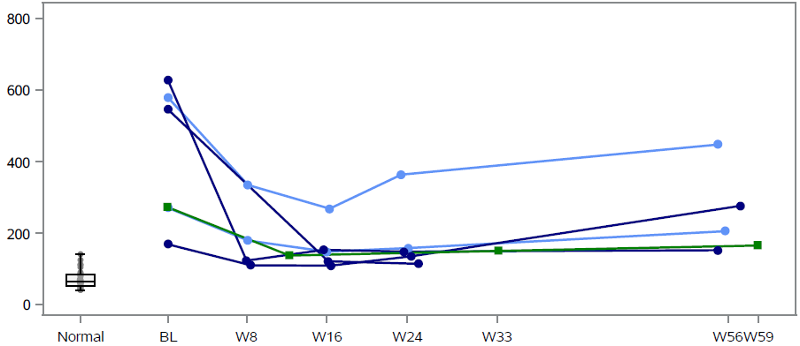

Cerebrospinal Fluid (CSF) GAGs
Heparan Sulfate (HS)
Individual Participants
Concentration (ng/mL)
Cohort 1 – Phase 1/2
Cohort 2 – Phase 1/2
Single Patient IND
Time on Study (Weeks)
Decreased CSF heparan sulfate in majority of participants through last time point available
Measurable CSF IDUA enzyme activity* in 4 of 5 participants in the Phase I/II trial and in the single patient IND participant
Note: Normative data are based on 29 normal samples.
Age ranges from 1 mo. to 21 years of age
Data not shown
Phase I/II Trial data cut: January 17, 2023
Single Patient IND data cut: December 12, 2021

Slide 7
Neurodevelopmental Assessments
  Age and developmentally appropriate validated instruments for neurodevelopmental testing were used to evaluate all participants
  n = 6 *
  Wechsler Abbreviated Scale of Intelligence (WASI-II) for chronological and development age > 6 years
  Vineland Adaptive Behavior Scale,
  Third Edition (VABS-III)
  n = 1
  1 Phase I/II trial participant
Bayley Scale of Infant and Toddler Development, Third Edition (BSID-III)
for chronological or developmental ages 0 to 42 months
Vineland Adaptive Behavior Scale,
Third Edition (VABS-III)**
n = 5
4 Phase I/II trial participants
1 single patient IND participant
* At least 6 months follow-up
** VABS only shown for older patient
Phase I/II Trial data cut: January 17, 2023
Single Patient IND data cut: December 12, 2021
Notes:
We also complete the VABS-III on the younger patients. The BSID-III provides a multi-domain assessment of cognition, language and motor skills, but since the WASI-II provides only cognition, the VABS-II was included to provide some insight into additional functional domains like daily activity and behavior

Slide 8
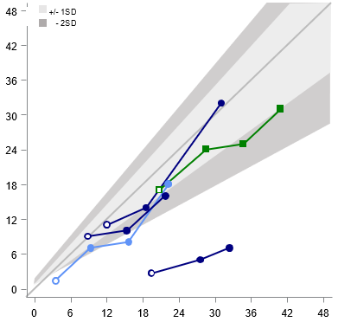
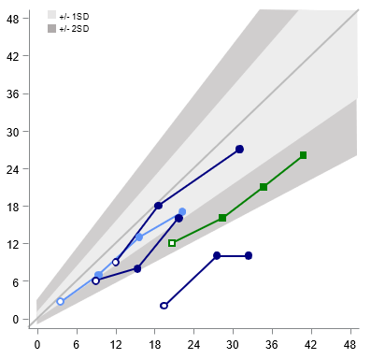
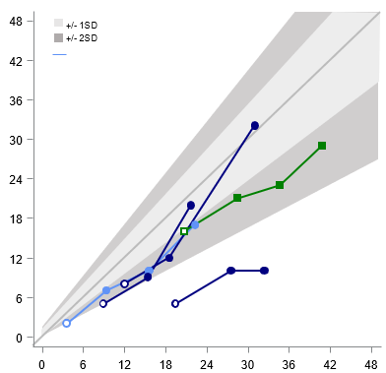
Neurodevelopmental Function
BSID-III
Cohort 1 – Phase I/II
Cohort 2 – Phase I/II
Single Patient IND
Cognition
Expressive Language
Fine Motor
+/
-
+/
1S
D
-
2S
D
Age Equivalence (months)
Age (months)
All participants show continued developmental skill acquisition on all subtests
At last assessment, 4 of 5 participants have function > -2 SD of normative mean on the cognition, expressive language and fine motor subtests
Includes participants (n = 5) with > 6 months of follow-up
Phase I/II Trial data cut: January 17, 2023
Single Patient IND data cut: December 12, 2021
Notes:
2 participants have achieved the BSID-III maximum subtest scores (42 months AEq) (to discuss)

Slide 9
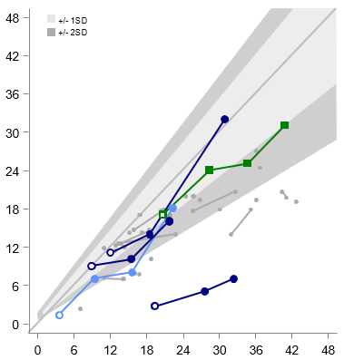
Neurodevelopmental Assessments and Function
BSID* Cognitive Subtest
BSID cognitive function in 2 participants** demonstrates higher AEq than available natural history data
Age Equivalence (months)
Cohort 1 – Phase I/II; n = 1
Cohort 2 – Phase I/II; n = 3
Single Patient IND; n = 1
Age (months)
* Natural history data (Shapiro et al., 2018) gathered using BSID-I and BSID-II; RGX-111 participants evaluated with BSID-III
** 1 participant in the Phase I/II trial and the single patient IND
Phase I/II Trial data cut: January 17, 2023
Single Patient IND data cut: December 12, 2021
Notes:
Natural history data included 9/32 patients who had received HSCT.

Slide 10
Neurodevelopmental Assessments and Adaptive Function for 13 Year Old Phase I/II Participant
WASI-II and VABS-III
VABS-III Age Equivalent Scores (year : month) | VABS-III Age Equivalent Scores (year : month)
Week of Assessment Age | Week of Assessment Age | BL 13y 2m | Week 52 14y 2m | Week 78 14y 8m
Communication | Receptive | 8:4 | 6:7 | 5:7
 | Expressive | 5:10 | 11:9 | 11:9 ↑
 | Written | 6:0 | 6:0 | 5:11
Daily Activity | Personal | 4:1 | 7:10 | 4:6 ↑
 | Domestic | 7:7 | 6:7 | 14:9 ↑
 | Community | 7:4 | 6:10 | 7:11 ↑
Socialization | Interpersonal Relationships | 5:10 | 7:4 | 22:0 ↑
 | Play and Leisure | 8:1 | 8:1 | 11:9 ↑
 | Coping Skill | 3:4 | 9:10 | 8:7 ↑
Adaptive Behavior | Adaptive Behavior | 6:3 | 7:10 | 10:3 ↑
Motor | Fine Motor | 5:7 | 6:4 | 6:3 ↑
 | Gross Motor | 4:0 | 4:6 | 3:2
WASI- II Composite Scores
Week of Assessment Age | BL 13y 2m | Week 52 14y 2m | Week 78 14y 8m
Verbal Comprehension Composite Score Mean of 100 SD15 | 45 | 55 | 67 ↑
Perceptual Reasoning Composite Score | 49 | 46 | 59 ↑
Full Scale-4 Composite Score | 43 | 47 | 61 ↑
Following RGX-111 administration, participant demonstrated improvements in WASI composite scores and
the majority of the VABS-II subdomains at last assessment
Phase I/II Trial data cut: January 17, 2023
Notes:
Examples of socialization skills acquired
Coping
Understands others actions may be accidental rather than intentional
Able to keep promises
Respects other’s time
Avoids being manipulated, dominated or taken advantage of by others
Interpersonal Relationships
Talks with others without interrupting or being rude
Starts conversations with others by talking about things that interest them
Participate in conversations on topics not of interest to him/her
Responds to hints or indirect cues in conversations
Provides additional explanation, when needed, in order for someone to follow what he/she is saying
Play and Leisure
Increase in ability to play games requiring skill and decision making
Goes places with peers during the day and evening with supervision
Obtains schedule information for movies, sports event, concert etc.

Slide 11
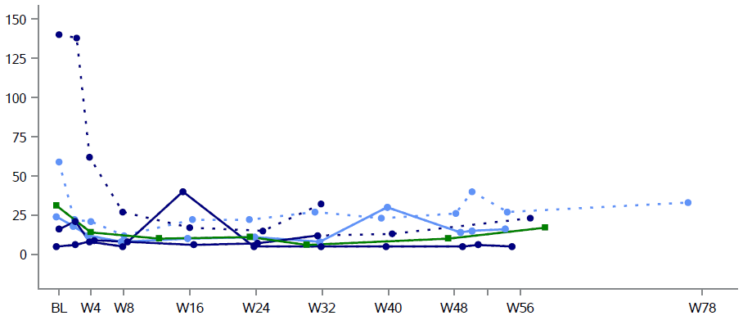

Systemic Effects: Plasma I0S6
I0S6 is a non-reducing end (NRE) disaccharide of glycosaminoglycans shown to be elevated in plasma,
urine and CSF of MPS I patients^{1,2,3,4,5}
Plasma I0S6 concentration (ng/ml)
Cohort 1 – Phase I/II
Cohort 2 – Phase I/II
Single Patient IND
Not on ERT / ERT naïve
Time on Study
Participants with elevated I0S6 at baseline showed a decrease in I0S6 following RGX-111 administration
Phase I/II Trial data cut: January 17, 2023
Single Patient IND data cut: December 12, 2021
1. Lawrence (2012) Nat Chem Biol 2. Vera (2019) Mol Genet Metab 3. Lund (2019) Sci Rep 4. Raymond (2016) Sci Rep 5. Eisengart (2019) Genet Med

Slide 12
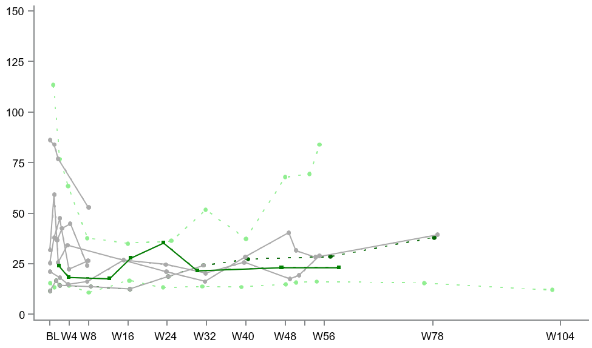

Systemic Effects
Urine Total GAGs
Total GAGs, urine (g/mol CK)
ERT naïve at dosing
Post ERT Withdrawal
ERT
Single Patient IND
Time on Study
Majority of patients maintained low levels of total urine GAGs
Phase I/II Trial data cut: January 17, 2023
Single Patient IND data cut: December 12, 2021
Notes:
Previous messaging: Total urinary GAGs remained below 30 g/mol in all participants at last time point available
Need info on 113-002

Slide 13
RGX-111 Phase I/II Trial and Single Patient IND
Summary of Interim Results
Safety: RGX-111 was well tolerated
8 participants were dosed in the Phase I/II trial and 1 in the single patient IND protocol
RGX-111 has been well tolerated with no SAEs related to study drug or administration procedure
CNS: Biomarkers and neurodevelopmental assessments indicate encouraging RGX-111 CNS profile
Biomarker:
  CSF GAG reduction and IDUA enzyme activity indicate CNS biological activity
Neurodevelopmental Function at Last Assessment Following RGX 111 Administration:
  The majority of participants showed continued skill acquisition ≥ -2 SD of normative mean on the BSID-III cognition, expressive language and fine motor subtests.
    Cognitive function in a Phase I/II trial participant and the single IND participant was higher than the age equivalent scores in the available natural history.
  The 13 year old participant demonstrated improved neurocognition and improved personal and social skills for daily living.
Emerging evidence of systemic biomarker activity after CNS administration of RGX-111
Plasma I0S6 reductions observed following RGX-111 administration
Low levels of total urine GAGs maintained in majority of participants
Phase I/II Trial data cut: January 17, 2023
Single Patient IND data cut: December 12, 2021

Slide 14
Acknowledgements
The RGX-111-002 Investigators
REGENXBIO
Nidal Boulos
Jenna Burke
Yoonjin Cho
Paulo Falabella
Michele Fiscella
Michelle Gilmor
Caroline Mulatya
Laura Pisani
Dawn Phillips
Catherine Wilson
Lin Yang
Can Ficicioglu, Children’s Hospital of Philadelphia
Roberto Giugliani, HCPA, Porto Alegre, Brazil
Yair Anikster, Sheba Medical Center, Israel
The Study Coordinators
(Nina Movsesyan, Harriet Chang, Ingrid Channa, Shoshana Franks, Genevieve Nesom, Ose Ehigiator, Marina Zambrano)
Research Assistants, and Study Teams
at the Clinical Study Sites
The MPS I patients
and their families

